Slide 1
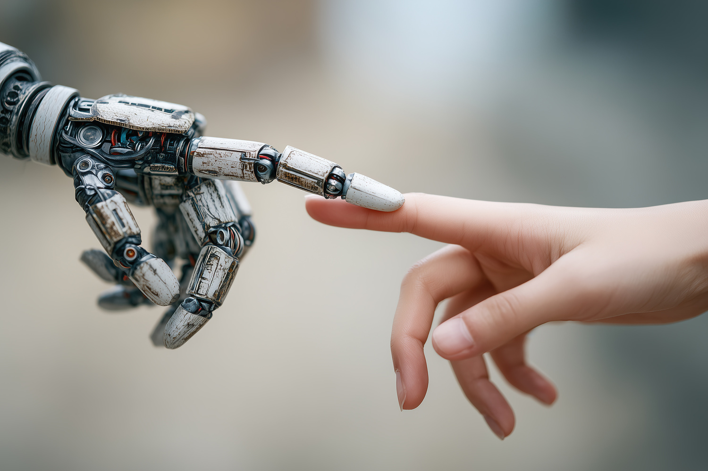
Daniel Riofrío
Computer Science and Applied and Computing Director

Slide 2
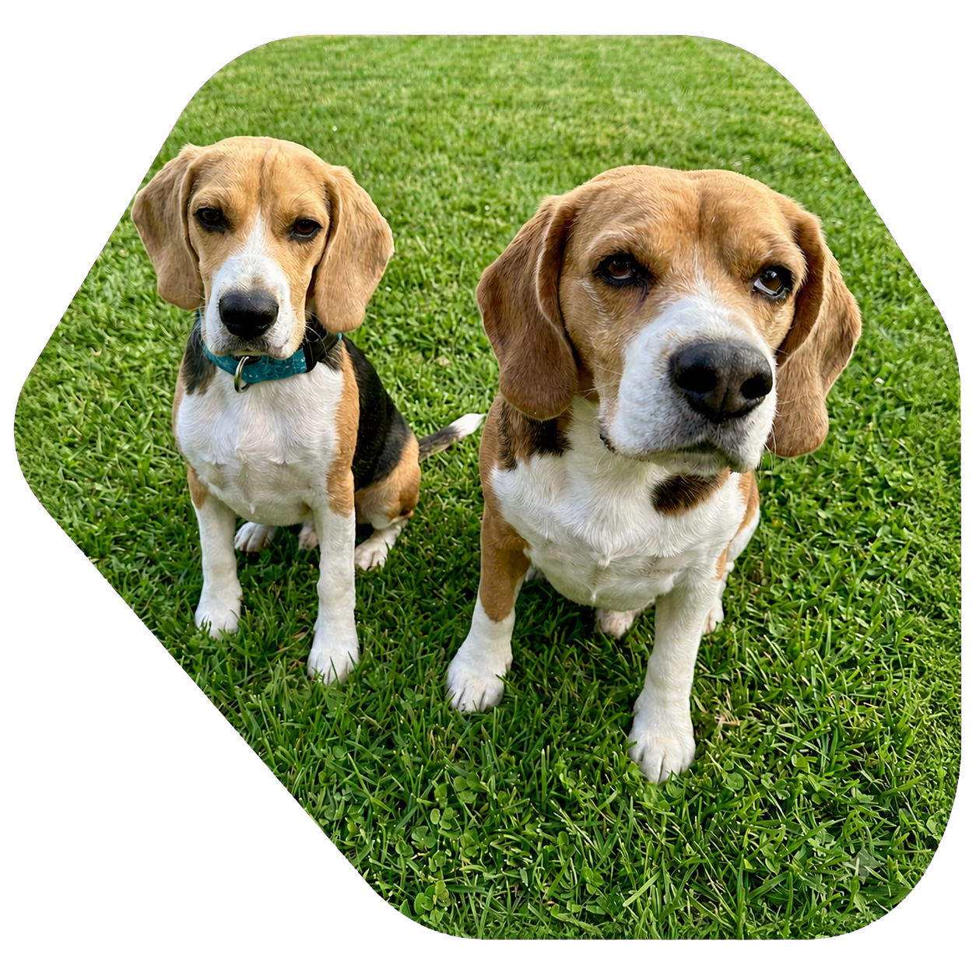
My profile
Ph.D in Computer Science - UNM
Computer Optimization and Applied ML
8+ years at USFQ
5+ years as Director of Computer Science
I love my beagles
Why AI?
2015
Ph.D
2018
SirPaul
2019
Danielita
2025
Ringo
TODAY
Who I am
CMP + MAC one direction

Slide 3

Contact channels
Email: driofrioa@usfq.edu.ec
Office: H317
Hours: MTWR 14:30 to 16:00
Course channel: D2L
Expected reply: up to 24h.
Telegram: @danielriofrio
Get in touch when needed

Slide 4
1. HISTORY AND FOUNDATIONS OF AI
2. INTELLIGENT AGENTS AND PROBLEM FORMULATION
3. HEURISTIC SEARCH FOR SOLUTIONS
4. ADVERSARIAL SEARCH IN GAMES
5. KNOWLEDGE, REASONING, AND PLANNING
6. PROPOSITIONAL AND FIRST-ORDER LOGIC: PROLOG, UNIFICATION, AND INFERENCE; FORWARD/BACKWARD CHAINING
7. UNCERTAINTY: PROBABILITY, BAYES’ THEOREM, AND NAIVE BAYES
8. TEMPORAL REASONING AND DYNAMIC MODELS: MARKOV
9. OPTIMIZATION AND BIO-INSPIRED ALGORITHMS
10. MACHINE LEARNING AND NEURAL NETWORKS: PERCEPTRON; ETHICS AND SAFETY
Course Content

Slide 5
Description | Category | Percentage of final grade | Assessment Date*
Homework 01 | Homework | 12 % | September 11
Homework 02 | Homework | 16 % | October 2
Homework 03 | Homework | 12 % | November 6
Midterm Exam 01 | Exams | 20 % | October 8
Midterm Exam 02 | Exams | 20 % | December 3
Final Project | Project | 20 % | December 7 - 17
* Dates may change depending on the dynamics of the class.
Important Dates

